Slide 1
Bottom Up Parsing

Slide 2
Bottom-Up Parsing
A bottom-up parser creates the parse tree of the given input starting from leaves towards the root
A bottom-up parser tries to find the right-most derivation of the given input in the reverse order.
S ⇒ ... ⇒ ω (the right-most derivation of ω)
← (the bottom-up parser finds the right-most derivation in the reverse order)

Slide 3
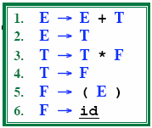
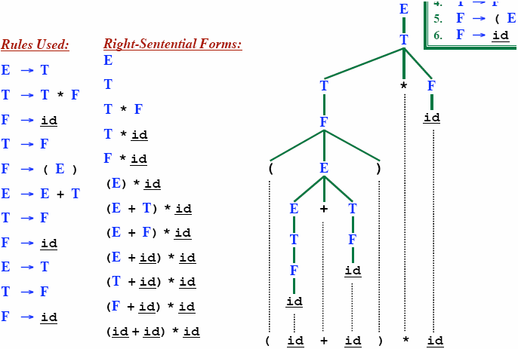
Rightmost Derivation

Slide 4
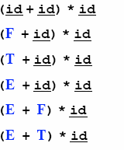
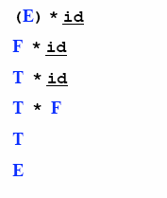
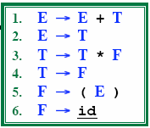
Reduction
A reduction step replaces a specific substring (matching the body of a production)
Reduction is the opposite of derivation
Bottom up parsing is a process of reducing a string ω
to the start symbol S of the grammar

Slide 5
Handle
Informally, a handle is a substring (in the parsing string) that matches the right side of a production rule.
– But not every substring matches the right side of a production rule is handle
A handle of a right sentential form γ (≡ αβω) is a production rule A → β and a position of γ
where the string β may be found and replaced by A to produce
*
the prevrimous rig_{r}h_{m} t-sentential form in a rightmost derivation of γ.
S ⇒ αAω ⇒ αβω

Slide 6
Handle Pruning
A right-most derivation in reverse can be obtained by
handle-pruning.
n-th right-sentential form
rm rm rm rm rm
S=γ₀ ⇒ γ₁ ⇒ γ₂ ⇒ ... ⇒ γ_{n-1} ⇒ γ_{n}= ω
input string
Start from γ_{n}, find a handle A_{n}→β_{n} in γ_{n}, and replace β_{n} in by A_{n} to get γ_{n-1}.
Then find a handle A_{n-1}→β_{n-1} in γ_{n-1}, and replace β_{n-1} in by A_{n-1} to get γ_{n-2}.
Repeat this, until we reach S.

Slide 7
Shift-Reduce Parsing
Bottom-up parsing is also known as shift-reduce parsing because its two main actions are shift and reduce.
data structures: input-string and stack
Operations
At each shift action, the current symbol in the input string is pushed to a stack.
At each reduction step, the symbols at the top of the stack (this symbol sequence is the right side of a production) will replaced by the non-terminal at the left side of that production.
Accept: Announce successful completion of parsing
Error: Discover a syntax error and call error recovery

Slide 8
Shift Reduce Parsing
S -> a T R e
T -> T b c | b
R -> d
Remaining input: abbcde
Rightmost derivation: S € a T R e
€ a T d e
€ a T b c d e
€ a b b c d e

Slide 9
Shift Reduce Parsing
S -> a T R e
T -> T b c | b
R -> d
Remaining input: bcde
€Shift a, Shift b
a b
Rightmost derivation: S € a T R e
€ a T d e
€ a T b c d e
€ a b b c d e

Slide 10
Shift Reduce Parsing
S -> a T R e
T -> T b c | b
R -> d
Remaining input: bcde
Shift a, Shift b
Reduce T -> b
T
a b
Rightmost derivation: S € a T R e
€ a T d e
€ a T b c d e
€ a b b c d e

Slide 11
Shift Reduce Parsing
S -> a T R e
T -> T b c | b
R -> d
Remaining input: de
Shift a, Shift b
Reduce T -> b
Shift b, shift c
T
a b
b c
Rightmost derivation: S € a T R e
€ a T d e
€ a T b c d e
€ a b b c d e

Slide 12
Shift Reduce Parsing
S -> a T R e
T -> T b c | b
R -> d
Remaining input: de
Shift a, Shift b
Reduce T -> b
Shift b, Shift c
Reduce T ->T b c
T
T
a b
b c
Rightmost derivation: S € a T R e
€ a T d e
€ a T b c d e
€ a b b c d e

Slide 13
Shift Reduce Parsing
S -> a T R e
T -> T b c | b
R -> d
Remaining input: e
Shift a, Shift b
Reduce T -> b
Shift b, Shift c
Reduce T ->T b c
Shift d
T
T
a b
b c d
Rightmost derivation:
S € a T R e
€ a T d e
€ a T b c d e
€ a b b c d e

Slide 14
Shift Reduce Parsing
S -> a T R e
T -> T b c | b
R -> d
Remaining input: e
Shift a, Shift b
Reduce T-> b
Shift b, Shift c
Reduce T-> T b c
Shift d
Reduce R->   d
T
T
R
a b
b c d
Rightmost derivation:
S € a T R e
€ a T d e
€ a T b c d e
€ a b b c d e

Slide 15
Shift Reduce Parsing
S -> a T R e
T -> T b c | b
R -> d
Remaining input:
Shift a, Shift b
Reduce T-> b
Shift b, Shift c
Reduce T-> T b c
Shift d
Reduce R-> d
Shift e
T
T
R
a b
b c d e
Rightmost derivation: S € a T R e
€ a T d e
€ a T b c d e
€ a b b c d e

Slide 16
Shift Reduce Parsing
S -> a T R e
T -> T b c | b
R -> d
Remaining input:
S
Shift a, Shift b
Reduce T-> b
Shift b, Shift c
Reduce T-> T b c
Shift d
Reduce R-> d
Shift e
Reduce S-> a T R e
T
T
R
a b
b c d e
Rightmost derivation: S € a T R e
€ a T d e
€ a T b c d e
€ a b b c d e

Slide 17
Example Shift-Reduce Parsing
Consider the grammar:
Stack
Input
Action
$ $id₁ | id₁ + id₂$ + id₂$ | shift reduce 6
$F | + id₂$ | reduce 4
$T | + id₂$ | reduce 2
$E | + id₂$ | shift
$E + | id₂$ | shift
$E + id₂ |  | reduce 6
$E + F $E + T $E |  | reduce 4 reduce 1 accept

Slide 18
Conflicts During Shift-Reduce Parsing
There are context-free grammars for which shift-reduce parsers cannot be used.
Stack contents and the next input symbol may not decide action:
shift/reduce conflict: Whether make a shift operation or a reduction.
reduce/reduce conflict: The parser cannot decide which of several reductions to make.
If a shift-reduce parser cannot be used for a grammar, that grammar is called as non-LR(k) grammar.
left to right scanning
right-mostk derivation
lookhead
An ambiguous grammar can never be a LR grammar.

Slide 19
Shift-Reduce Conflict in Ambiguous Grammar
stmt → if expr then stmt
| if expr then stmt else stmt
| other
STACK
….if expr then stmt
INPUT
else….$
We cant decide whether to shift or reduce?
But we can adapt to parse certain ambiguous grammar to using shift-reducing parsers
– We resolve in favor of SHIFT then we have a solution

Slide 20
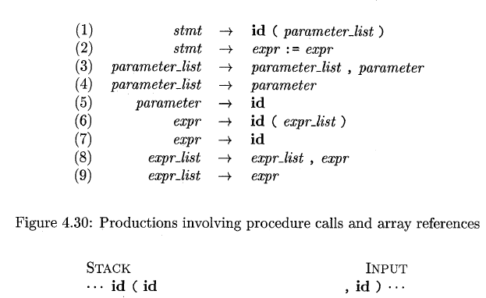
Reduce-Reduce Conflict in Ambiguous Grammar
We have to reduce id
We can use both (5) and (7) to reduce id

Slide 21
References
Compilers, Principles Techniques and Tools by Alfred Aho – Monica Lam- Ravi Sethi-Jeffrey Ullman (2nd edition)

